Slide 1











Oct
11
The Big Bang
Define the Big Bang Hypothesis for how the universe began
State that the universe is expanding
Workbook or laptop (for writing)
Pen
Write down the four main types of galaxies.
1. Spiral 2. Barred spiral
3. Elliptical 4. Irregular
Write down the four main types of galaxies.
Learning about the Big Bang theory
Learn about universe expansion
Applying understanding
Notes:
Font: Coconutz by typefactory on fontspace.com

Slide 2

The Big Bang

Slide 3
Big Bang Timeline
The Big Bang
Please draw the timeline!
Our sun is born, the heavy elements around it clump into planets
Modern Times
13.7 Billion Years Ago (BYA)
5 BYA
3.8 BYA
The beginning of the universe
Simple life evolves on Earth
You were born
Notes:
I start this page by asking the students “What is this?” Usually someone will answer that it is a timeline, to which I reply “This is a timeline of the universe. It highlights the four most important moments in history.” I then reveal the four points and talk briefly about each one as they copy it down on their notes.

Slide 4
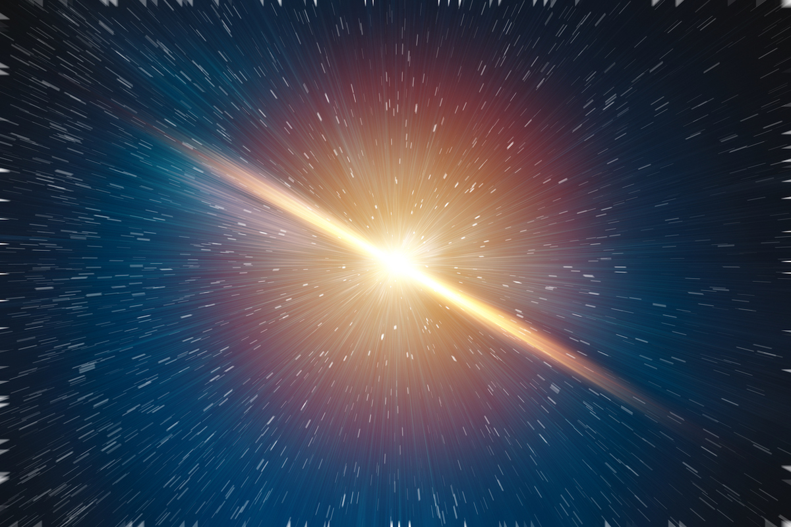
The Big Bang Theory
The Big Bang
The Big Bang Theory is a theory about:
What the universe was like in the beginning
What is happening in the universe now.

Slide 5
The Big Bang
The Big Bang
What we know:
The universe is expanding
The universe started out small, hot and dense
The universe is cooling down as it expands
The big bang wasn’t a “bang” at all. There was no explosion, just an explosive expansion, triggered by an unknown event.

Slide 6
The Big Bang
The Big Bang
The Universe Today
The Universe
1 million years ago
Notes:
. I like to start with the idea that the universe is expanding because it leads well into why we believe that the universe used to be a very small place. As you click the button all of the other layers of the universe fade away leaving just the small universe from way back when. I discuss this with the students explaining that if the universe was bigger now than it was 10 million years ago, and it was constantly getting smaller as you go back in time, then you come to a time when the universe was very small. Incredibly small. As hard as this is for us to wrap our brains around, the universe was at one time small enough to fit in this room. Can you imagine how dense that would be? What would the temperature be like in such a dense place? Imagine if we packed 300 students into this classroom – what would happen to the temperature. So, the next thing that I want you to remember about the universe is that…

Slide 7
The Big Bang
The Big Bang
How do we know?
Knowing that the universe is still expanding is the easy part…
Explaining and understanding the evidence is the tricky part… and that’s what we’ll be covering next..

Slide 8
Close your books and put them away
Let’s check your understanding
With a quick Quiz
Get ready…

Slide 9

Quiz: True or False
Please answer using the exit ticket sheet provided.
1. The Big Bang Theory is about how the Earth was created.
False
2. The Big Bang Theory states that the Earth is getting bigger.
False
Notes:
Exit ticket ppt – slide 34
Ensure that the sheet is swapped with a peer for marking before revealing the answers!
T/F The Big Bang Theory is a theory about how the Earth was created. FALSE! We are talking the entire universe here. The Earth has only been around for 5 billion years or so, the universe is almost three times that old. T/F The big bang theory says that the Earth is getting bigger. FALSE! It says the the universe is getting bigger, that it is expanding. This does not mean that everything in the universe is getting bigger. Think of a balloon. If I blow up a balloon a little bit and then I put a peanut inside, and then I kept on blowing it up bigger and bigger, causing the balloon to expand, what happens to the peanut? Nothing! We are that peanut.

Slide 10




Oct
11
The Big Bang
Define the Big Bang Hypothesis for how the universe began
State that the universe is expanding
Notes:
Font: Coconutz by typefactory on fontspace.com

Slide 11
Sep
20
Evidence of the Big Bang
State the evidence for the Big Bang Theory including:
Red and blue shift
Cosmic microwave background radiation
Workbook or laptop (for writing)
Pen
What are the 3 most important things to remember about the big bang theory?
The Universe is expanding
The universe started out small, hot and dense
The Universe is cooling down as it expands
What are the 3 most important things to remember about the big bang theory?
Learning about the doppler effect
Learning about red shift
Learning about cosmic microwave background radiation
Applying understanding
Notes:
Font: Coconutz by typefactory on fontspace.com

Slide 12
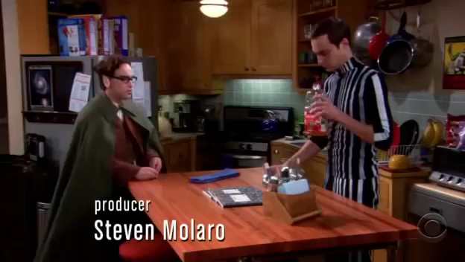
Evidence for the Big Bang

Slide 13
Doppler Effect 1
Evidence for the Big Bang
Have you ever observed that when an ambulance or police car drives past you, its siren his high-pitched as it comes towards you, then becomes low-pitched as it moves away from you?
This effect is called the Doppler effect and can be defined as “the apparent change in the frequency of a wave caused by relative motion between the source of the wave and the observer.”

Slide 14
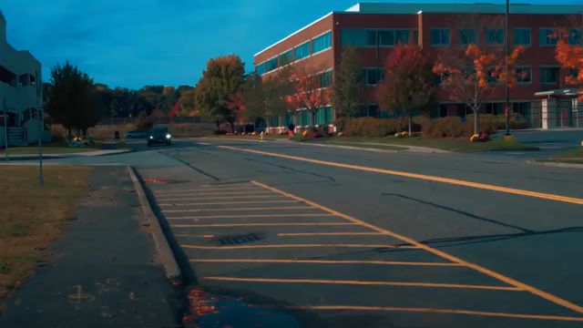
Doppler Effect
Evidence for the Big Bang

Slide 15
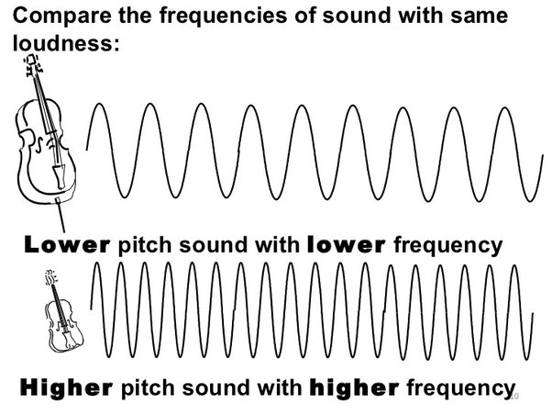
The Doppler Effect 2
Evidence for the Big Bang
We hear different pitches of sound based on its frequency (how often the wavefronts hit our ears).
When a sound wave has a high frequency, it has a higher pitch.
When a soundwave has a lower frequency, it has a lower pitch.

Slide 16
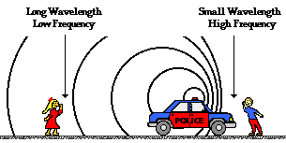
The Doppler Effect 3
Evidence for the Big Bang
When an object is moving either towards you or away from you, the frequency at which the wavefronts hit your ears changes.
If it is moving towards you, the wavefronts bunch up, resulting in a high frequency and a high pitch.
If it is moving away from you, the wavefronts are stretched out, resulting in a low frequency and a low pitch.
Please draw the diagram!

Slide 17
The Doppler Effect 4
Evidence for the Big Bang
It is important to note that the effect does not result because of an actual change in the frequency of the source.
Looking at the diagram, you can see that the effect is only observed because the distance between observer B and the police car is decreasing and the distance between the observer A and the police car is increasing.
As a result, it appears to the observer whom the police car is approaching that the disturbances are being produced at a higher frequency.

Slide 18
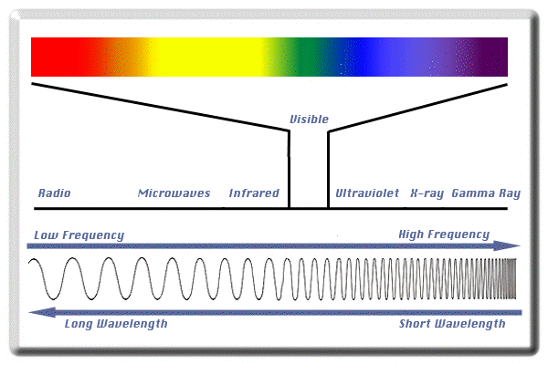
Light Spectrum
Evidence for the Big Bang
Light is a wave, like sound.
Light with high frequency looks more blue. Light with a low frequency looks more red.
What do you think would happen if a light is moving towards you?

Slide 19
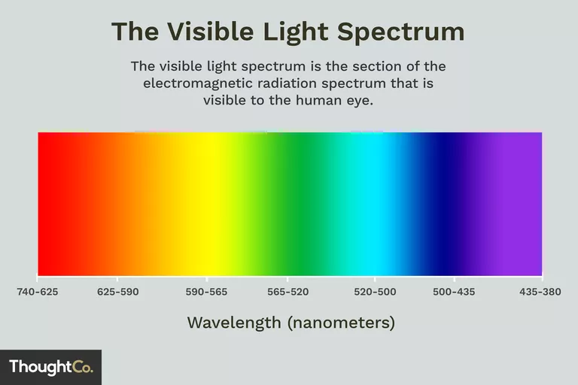
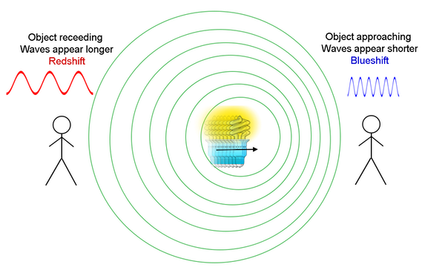
Doppler Effect and Red Shift
Evidence for the Big Bang
Visible light spectrum

Slide 20

Evidence for the Big Bang

Slide 21
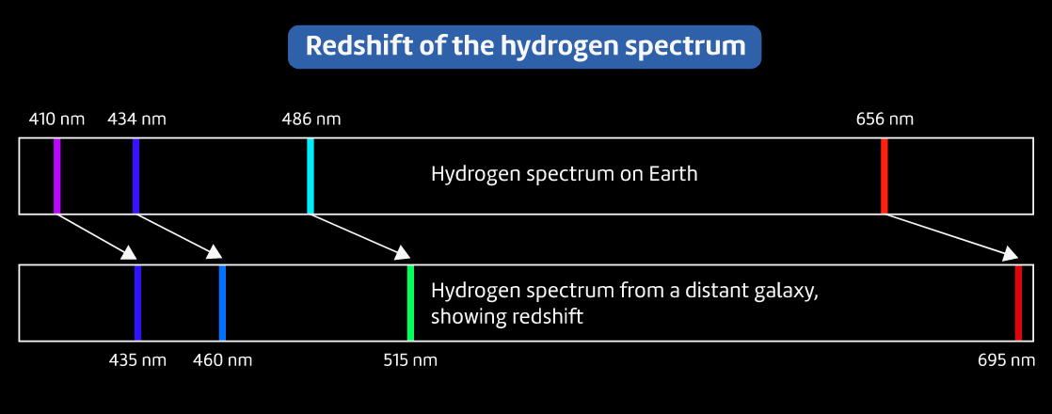
Red Shift 1
Evidence for the Big Bang

Slide 22
Red Shift 2
Evidence for the Big Bang
The light we observe from distant galaxies is redshifted. This means it has a lower frequency than we would observe if the galaxy was stationary.
This means that the galaxies are moving away from us.
The interesting part:
All the distant galaxies around us are moving away from us in all directions.
This is evidence that the universe (3D space itself) is expanding. There is a larger and larger distance between all galaxies all the time → space itself is expanding…

Slide 23
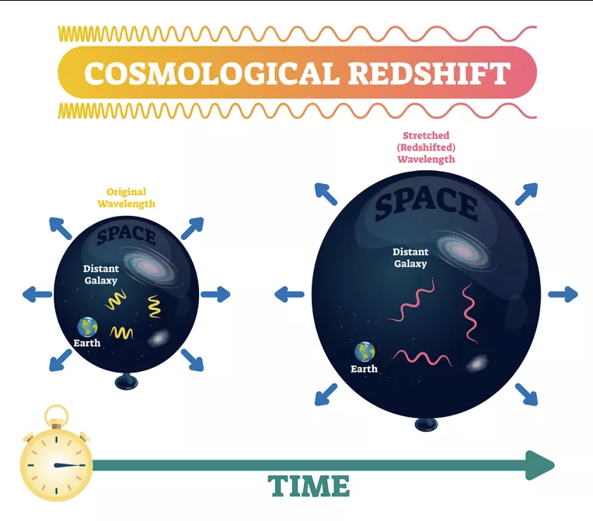
Red Shift 3
Evidence for the Big Bang

Slide 24
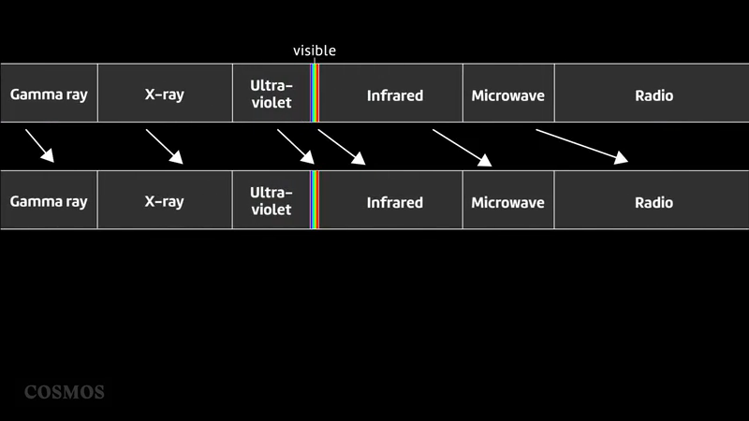
Evidence for the Big Bang

Slide 25
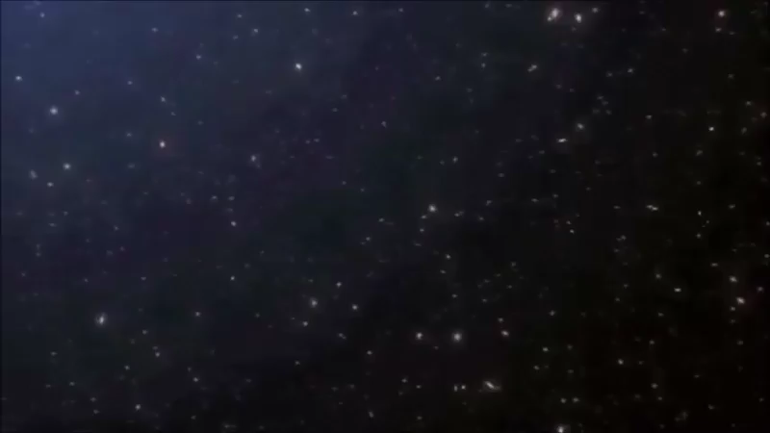
Evidence for the Big Bang

Slide 26
Cosmic Microwave Background Radiation 1
Evidence for the Big Bang
Everywhere we look in space there is a faint layer of energy known as Cosmic Microwave Background (CMB) Radiation.
It is nearly the same temperature and wavelength, implying that it all cam from the same event.
If the universe was initially as hot as the Big Bang theory suggests, then we should be able to find some remnant of this heat which appears to be CMB radiation.

Slide 27

Cosmic Microwave Background Radiation 2
Evidence for the Big Bang
CMB radiation is in the microwave part of the electromagnetic spectrum and comes from all directions in outer space. It is the oldest electromagnetic signal that we can detect.
Arno Penzias and Robert Wilson first detected the CMB radiation in 1964 and received a Nobel Prize in Physics in 1978 for the discovery and the existence of CMB radiation is important evidence that the Big Bang theory is true.

Slide 28
Cosmic Microwave Background Radiation 3
Evidence for the Big Bang
It is difficult to observe CMB radiation with ground-based instruments so much air and space-borne research has been conducted.
The Cosmic Background Explorer (COBE) satellite that was flown from 1989-1996 is probably the most famous and is what made the first detection of large-scale fluctuations in CMB radiation.
In June 2001, NASA launched a CMB radiation space mission, MWAP, to make more accurate measurements.

Slide 29
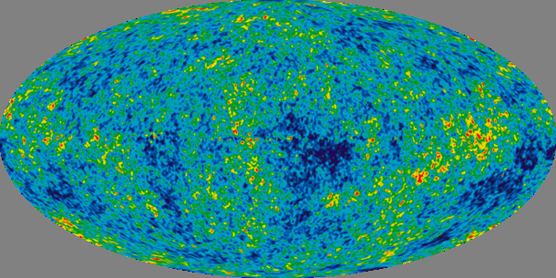
Cosmic Microwave Background Radiation 4
Evidence for the Big Bang
The image below is an all-sky map of the CMB radiation created from 9 years of WMAP data.

Slide 30
Close your books and put them away
Let’s check your understanding
With a quick Quiz
Get ready…

Slide 31
Quiz:
Please answer using the exit ticket sheet provided.
1. Slipher’s observations of the light emitted by galaxies indicated that most galaxies:
Stay in fixed positions
Are moving towards a common point
Are moving towards us
Are getting further away from us
2. Define redshift:
The colour of the light that moving galaxies emit
The colour of the light emitted by atoms heated to high temperatures
The stretching of light waves emitted by objects moving in any direction
The stretching of light waves emitted by objects moving away from us
Notes:
Exit tickets ppt – slide 35

Slide 32
Quiz:
Please answer using the exit ticket sheet provided.
3. Hubble compared the distances of galaxies with the amount their light had been redshifted. Recall what he discovered
Galaxies are all getting further away from us at the same speed
The further away a galaxy is, the slower its moving
The further away a galaxy is, the faster it’s moving
None of the above
4. Recall how Einstein’s general theory of relativity explains Hubble’s discovery.
The redshifted galaxies are moving away from us through space
The space between galaxies is expanding, so the redshifted galaxies are getting further away from us
The Earth is at the centre of the universe so everything is moving away from us
The light from different galaxies is changing speed

Slide 33

Answers:
Please swap your sheet with someone else to be marked.
Answers:
1. D 2. D 3. C 4. B
Don’t mind me,
I’m just collecting data

Slide 34

June
08
The Big Bang
State the evidence for the Big Bang Theory including:
Red and blue shift
Cosmic microwave background radiation
Notes:
Font: Coconutz by typefactory on fontspace.com

Slide 35
Quiz: True or False
Please answer using the exit ticket sheet provided.
1. The Big Bang Theory is about how the Earth was created.
False
2. The Big Bang Theory states that the Earth is getting bigger.
False
Notes:
Exit ticket ppt – slide 35

Slide 36
* BRAIN BREAK *
Touch your left ear with your right hand.
Now take a deep breath and close your eyes.
On each count, take a deep breath in, and release.
Now, touch your nose with your left hand
Now switch… right ear and left hand, nose with right hand
And switch… left ear and right hand, nose with left hand
Notes:
Get students to complete brain break exercise then do a deep cleansing breath to release and resettle.
Instruct students to take a deep breath and close their eyes.
Slowly count down from 5 and tell students to take a deep breath on each count.
At 1, tell students to open their eyes and resume the lesson.

Slide 37
Close your books and put them away
Form 5 groups
Get your brain ready…
It’s time to play attack!

Slide 38
GAME RULES
1. Only the selected person on the team can answer the question (no help!)
2. If you get the answer right you get to attack! Get it wrong, another team gets a go.
3. Once you’ve been attacked 5 times, that team can’t win (but you can still attack others).
4. Last team standing wins!

Slide 39
Put your books away
Collect a whiteboard, marker & cloth
New Rule:
Each correct answer gets a point… top 3 most points get lollies!
Get your brain ready…
It’s time to test your knowledge!

